Slide 1
Evaluation and selection of a workflow engine to enable automated
3D data processing pipelines in the context of aircraft retrofitting

Slide 2
Table of Contents
1. | Introduction and motivation
2. | Core Project Tasks
3. | State of the art
4. | Requirements of the software system
5. | Selection of a workflow Engine
6. | Conceptual 3D Data Processing Pipeline
7. | Evaluation
8. | Conclusion and Outlook
Presentation on Research Project
Table of Contents
-

Slide 3


Introduction and motivation
Real life 3D Object
3D measurement system
3D Point Clouds
Processing-1
Processing-2
…
Processing-n
Mesh
Meshlab
CloudCompare
hardware intensive
Long execution time
Repetitive
Presentation on Research Project
Introduction and Motivation
-
Notes:
Aircraft go through many retrofitting or modification processes during their entire life span. Detailed information regarding various parts of the fuselage and cabin is required for these types of operations, which is usually provided by 3D images of cabins consisting of point clouds or CAD data [1]. These images can be used as the cabin’s digital copy of its current state within a digital twin [2]. Generally, 3D laser scanners are used to convert the whole cabin or parts of the cabin into 3D point clouds [3]. These 3D cloud points are processed through many steps before we get viable 3D images.

Slide 4
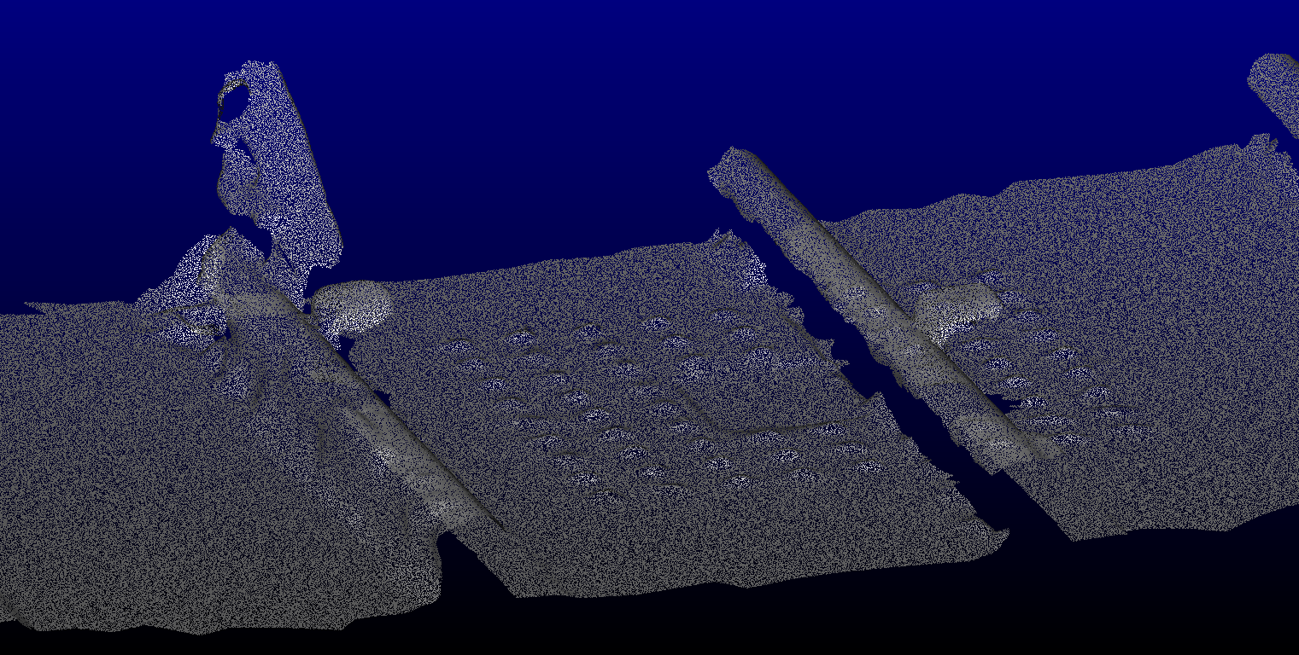
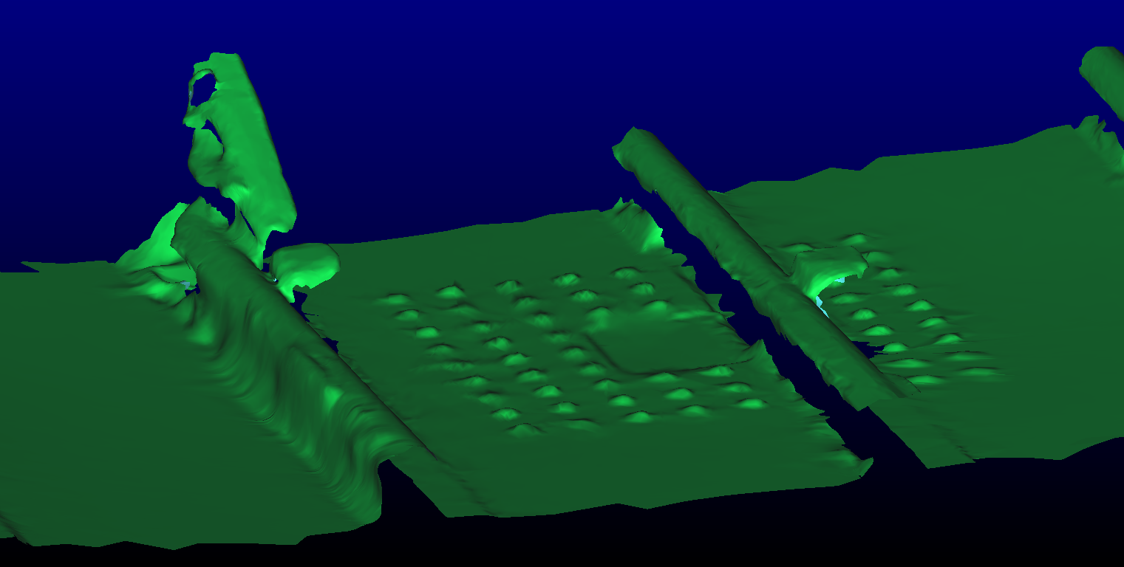
Introduction and motivation
Artifacts generated by a 3D data processing pipeline
[1]
Presentation on Research Project
Introduction and Motivation
-
Notes:
In this slide we can see how manually the whole mesh process takes place. After the using the 3d measurement system we get some point clouds with different alignments, which are then roughly aligned manually , then mesh is created after doing some pre processing like computing normal.

Slide 5







Introduction and motivation
3D Data Processing using Workflow Engine
[2]
Reduces Execution time
Appropriate error handling
3D Data Processing Pipeline
Workflow Engine
Parallel processing
Reduction of human interaction
Presentation on Research Project
Introduction and Motivation
-
Notes:
So in this project the question we must find answer to is does a workflow engine (Argo Workflow or Apache Workflow) increase the level of automation of a 3D data processing pipeline in terms of:
overall processing time
ease of use
Where:
overall processing time includes execution time and time needed for manual interaction
ease of use: is a non-expert capable of using the workflow engine: usability, authoring tools , implementation and monitoring

Slide 6
Table of Contents
1. | Introduction and motivation
2. | Core Project Tasks
3. | State of the art
4. | Requirements of the software system
5. | Selection of a workflow Engine
6. | Conceptual 3D Data Processing Pipeline
7. | Evaluation
8. | Conclusion and Outlook
Presentation on Research Project
Table of Contents
-

Slide 7
Core Project Tasks
Analysis
Implementation
Evaluation
Requirements formulation
Installation and configuration
Executing workflow using pre-processed test data
Evaluation of Workflow Engine
Implementation of tasks using third party Software
Performance Evaluation of the implemented pipeline
Selection of a workflow engine (AA or AW)
Presentation on Research Project
Core Project Tasks
-

Slide 8
Table of Contents
1. | Introduction and motivation
2. | Core Project Tasks
3. | State of the art
3.1 | Workflow Engine
3.2 | Apache Airflow and Argo Workflow
3.3 | Workflow Engines in 3D data Processing
4. | Requirements of the software system
5. | Selection of a workflow Engine
6. | Conceptual 3D Data Processing Pipeline
7. | Evaluation
8. | Conclusion and Outlook
Presentation on Research Project
Table of Contents
-

Slide 9
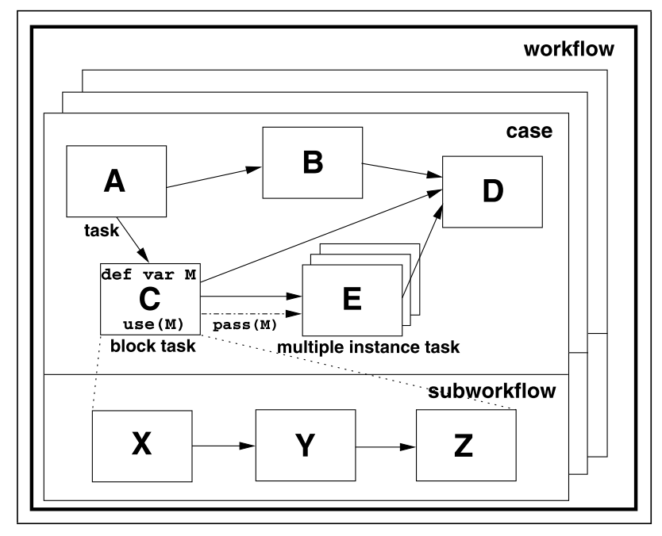
Workflow Engine
So what is a Workflow Engine?
[3]
Software systems that facilitate the automation of a workflow
A workflow consists of several processes
Defines Workflows in DAGs
Presentation on Research Project
Workflow Engine
-

Slide 10
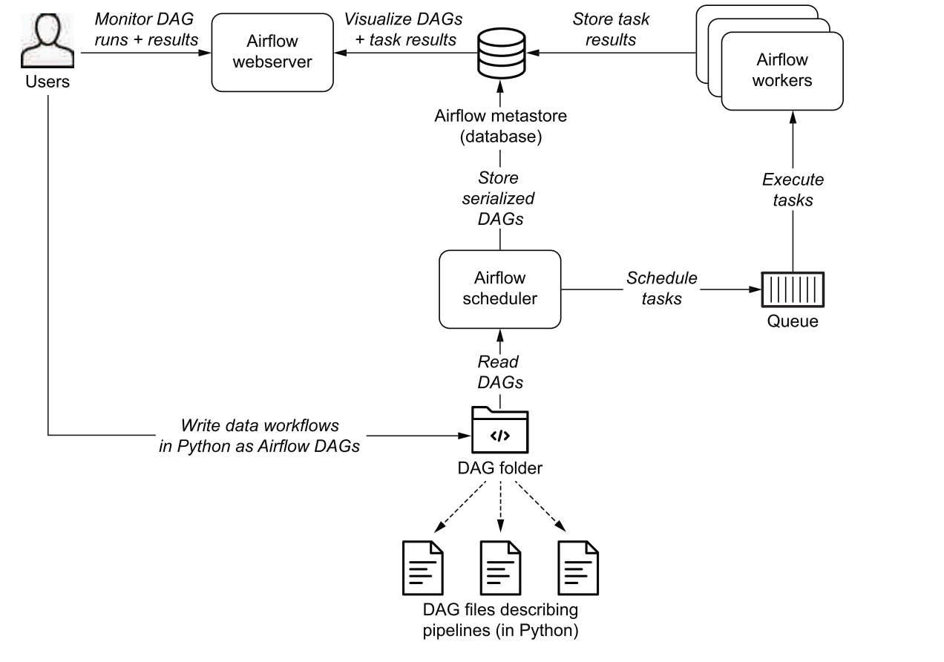
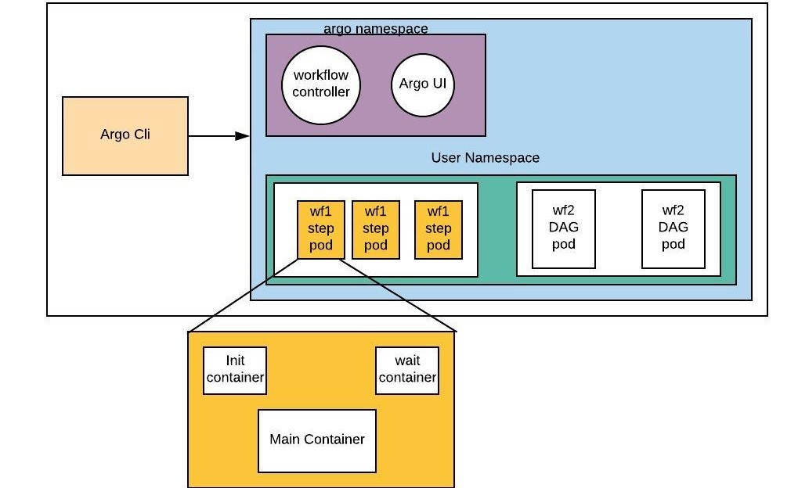
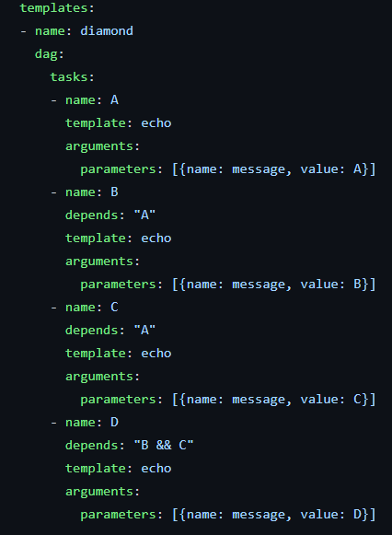
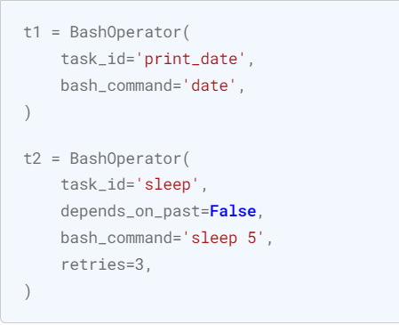
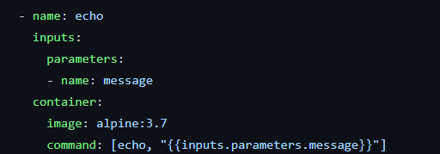
Apache Airflow and Argo Workflow
[4]
Apache airflow
Argo Workflow
[5]
Presentation on Research Project
Apache Airflow and Argo Workflow
-

Slide 11
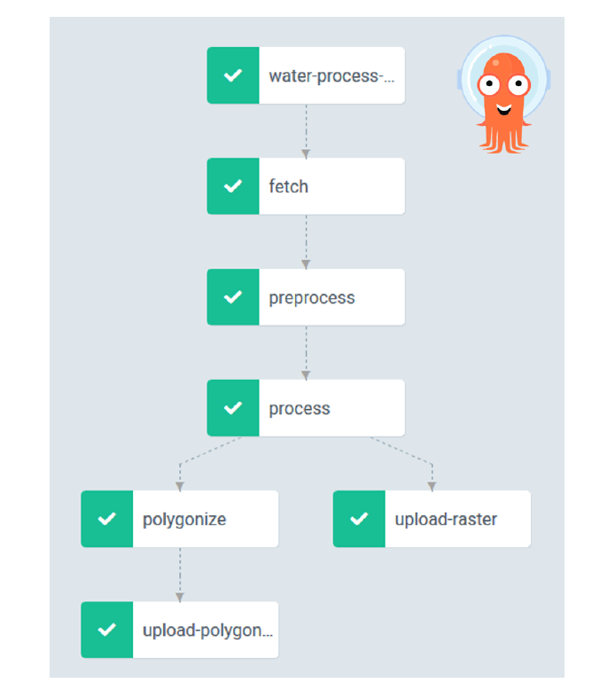
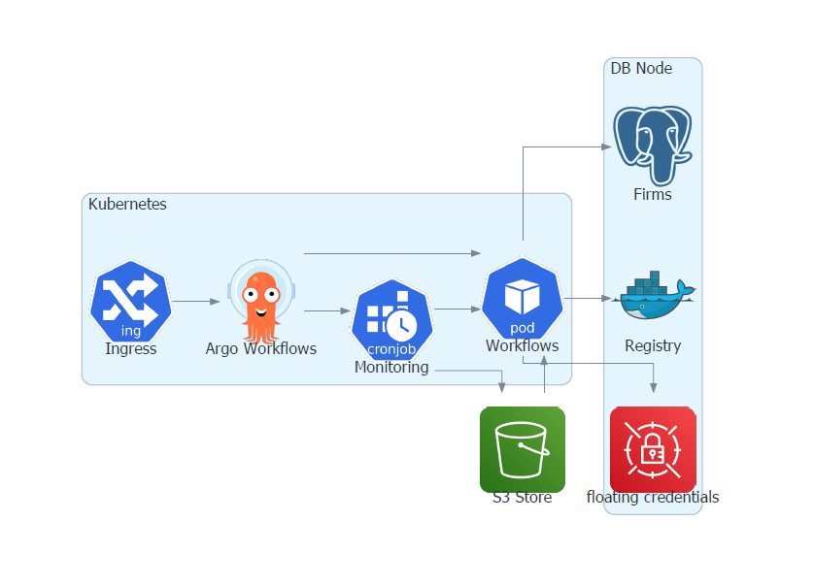
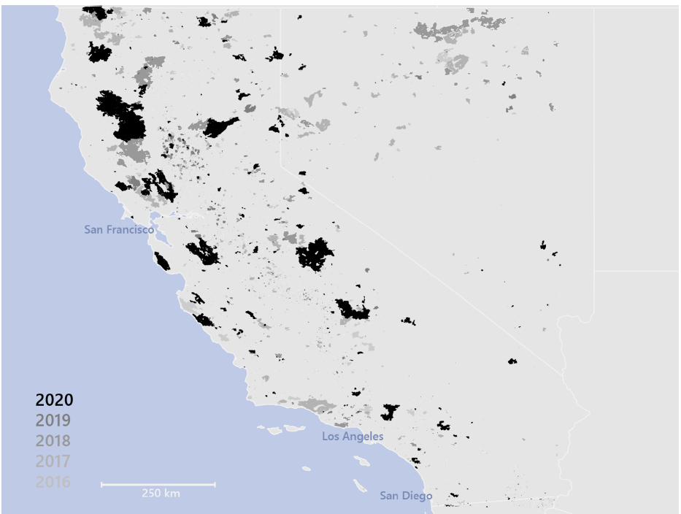
Workflow Engines in 3D data Processing
Scalable Processing Of Copernicus Sentinel satellite Images Using Argo Workflows
[6]
Processing Architecture
Results
DAG Structure
Presentation on Research Project
Workflow Engines in 3D data Processing
-
Notes:
Here we will take a look at an example research work involving workflow engine. In the paper titled Scalable Processing Of Copernicus Sentinel satellite Images Using Argo Workflows, they successfully deployed a satellite image processing pipeline using Argo workflow. Where data from satellite images is processed for flood detection and burnt area monitoring.
I chose this particular work as an example because this the is closet thing I cloud find where workflow engine is used for 3d data processing. I am yet to see a research work that takes full advantage of workflow engines for processing 3D point clouds. So our work could be a first attempt of trying that.

Slide 12
Table of Contents
1. | Introduction and motivation
2. | Core Project Tasks
3. | State of the art
4. | Requirements of the software system
5. | Selection of a workflow Engine
6. | Conceptual 3D Data Processing Pipeline
7. | Evaluation
8. | Conclusion and Outlook
Presentation on Research Project
Table of Contents
-

Slide 13










Requirements of the software system
[7]
Functional Requirements
Non-Functional Requirements
Loading and saving 3D data object
Notification system
Containerization of tasks
Detailed logs of the pipeline execution
Artifact storage system
Version controlled DAG/Task editing
Visual workflow editor
Appropriate error handling
Reusable task template
Appropriate UI usability for non-expert
Deployment in kubernetes
Presentation on Research Project
Requirements of the software system
-

Slide 14
Table of Contents
1. | Introduction and motivation
2. | Core Project Tasks
3. | State of the art
4. | Requirements of the software system
5. | Selection of a workflow Engine
6. | Conceptual 3D Data Processing Pipeline
7. | Evaluation
8. | Conclusion and Outlook
Presentation on Research Project
Table of Contents
-

Slide 15
Selection of a Workflow Engine
Average Weight-score analysis
 | Apache Airflow | Argo Workflow
Functional Requirements | 3.4 | 4.2
Non-Functional Requirements | 4.1 | 4.12
Presentation on Research Project
Selection of a Workflow Engine
-

Slide 16
Table of Contents
1. | Introduction and motivation
2. | Core Project Tasks
3. | State of the art
4. | Requirements of the software system
5. | Selection of a workflow Engine
6. | Conceptual 3D Data Processing Pipeline
6.1 | Conceptual Pipeline
6.2 | Different Components of Conceptual Pipeline
7. | Evaluation
8. | Conclusion and Outlook
Presentation on Research Project
Table of Contents
-

Slide 17
Conceptual Pipeline
Kubernetes cluster
Process 1
Pod 1
Runtime image 1
Process 2
Pod 2
Runtime image 2
DAG
Processed Data
Process 3
Pod 3
Runtime image 3
Load 3D data
Process N
Pod N
Runtime image N
Storage unit for artifact passing
Presentation on Research Project
Conceptual Pipeline
-
Notes:
Conceptually the pipeline would be created using a workflow engine (Argo or Airflow) and executed in a Kubernetes cluster. The workflow engine defines tasks, dependencies, input-output artifacts, runtime images, and all the other details of the pipeline using DAG files.

Slide 18
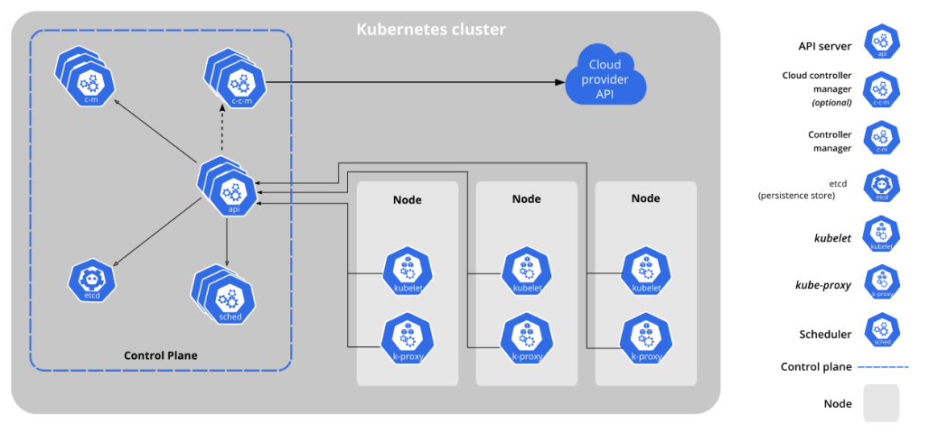
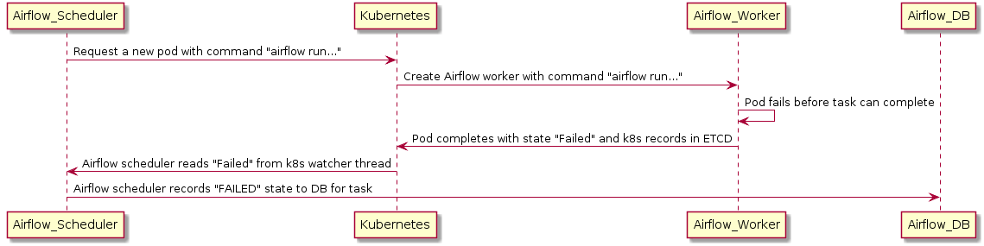
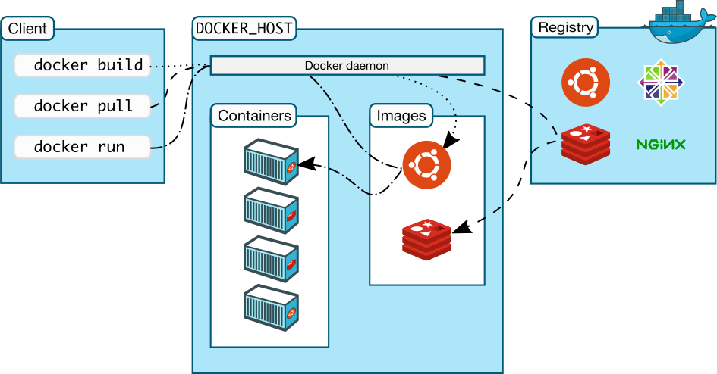
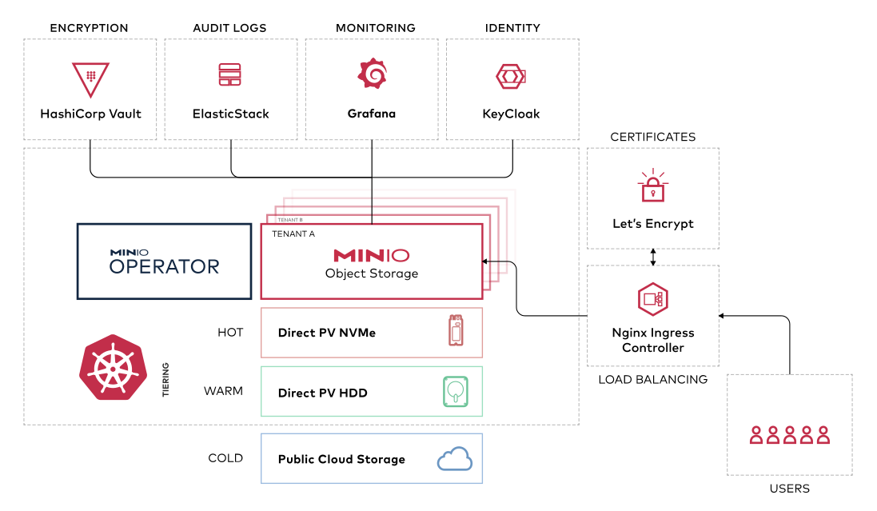
Different Components of Conceptual Pipeline
[8, 9, 10, 11]
Kubernetes Cluster
Fault Handling
Containerization of tasks
Artifact handling/Storage unit (s3)
Presentation on Research Project
Different Components of Conceptual Pipeline
-
Notes:
Docker consists of a docker client, daemon, and registry. The Docker client communicates with the docker daemon which performs tasks like building, running and distribution of docker containers [19]. we can practically run any type of software
or services in any kind of environment regardless of the environment of the machine running them.
we can see different components of a Kubernetes cluster. Control Plane consists of Kube-api service, etcd, kube-scheduler, and Kube-controller-manager. It makes the global decision about cluster organization. It uses etcd to store key values
related to all information regarding the deployed cluster. Kube-scheduler keeps track of newly created pods without an assigned node and selects a node to run them. The Kube-control-manager manages the whole control process. Nodes maintain pods and their run, creating a Kubernetes runtime environment.
• It can manage multiple docker containers across multiple servers or nodes
• Has an out-of-the-box tool for dynamic resource provisioning
• Provides adaptive scalability
Kubernetes watcher thread can keep track of every change that happens in the Kubernetes database. It also keeps track of when pods are created, running, and failed [6]7. This type of monitoring facilitates the discovery of crashed pods and correctly reporting task failure.
There are multiple reasons for choosing s3 storage system which are as follows [33]:
• User can choose a region that is better for latency and optimizes cost.
• Objects are stored in buckets with a unique key
• Number of objects that can be stored is unlimited
• Up to 5 terabytes of storage facility

Slide 19
Table of Contents
1. | Introduction and motivation
2. | Core Project Tasks
3. | State of the art
4. | Requirements of the software system
5. | Selection of a workflow Engine
6. | Conceptual 3D Data Processing Pipeline
7. | Evaluation
7.1 | Example 3D data processing pipeline
7.2 | The automated pipeline
7.3 | Artifacts generated by the pipeline
7.4 | Performance Evaluation
8. | Conclusion and Outlook
Presentation on Research Project
Table of Contents
-

Slide 20
Example 3D data processing pipeline
CloudCompare
Roughly Aligned Point Clouds
Fine Registration/ ICP
Statistical Outlier Removal
Computing Normal
Surface Reconstruction/ Mesh
Merging Close Vertices
Meshlab
Presentation on Research Project
Example 3D data processing pipeline

Slide 21







The automated pipeline
Kubernetes cluster
Fine Registration ICP, MERGE
Pod 1
ifte110/cc-new
output.bin
DAG
SOR
Pod 2
ifte110/cc-new
output_sor.ply
Mesh
Pod 3
ifte110/pym
output_mesh_mcv.bin
Input: Roughly Aligned Point Clouds
Minio Artifact Storage
Presentation on Research Project
The automated pipeline
-

Slide 22
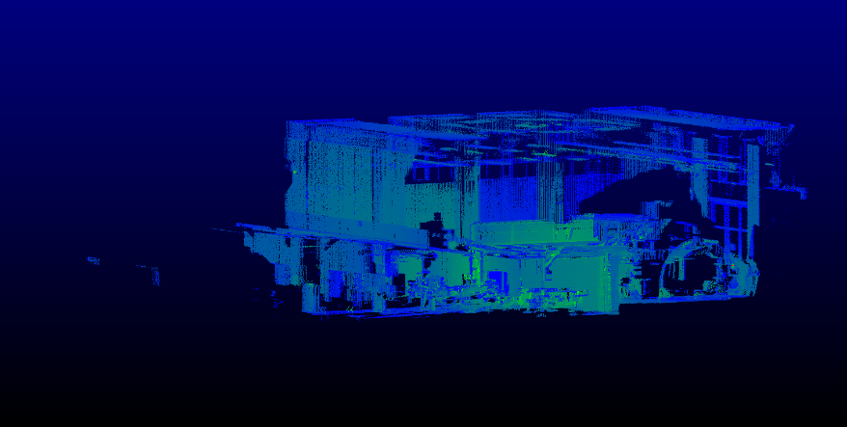
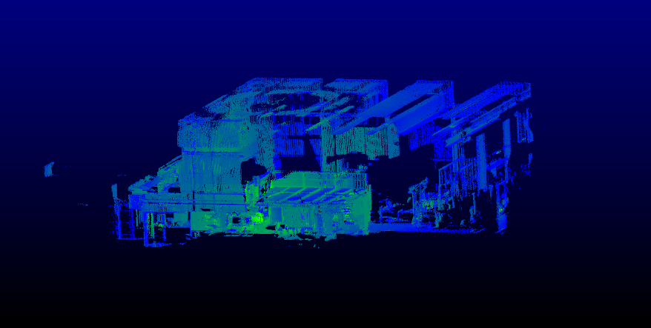
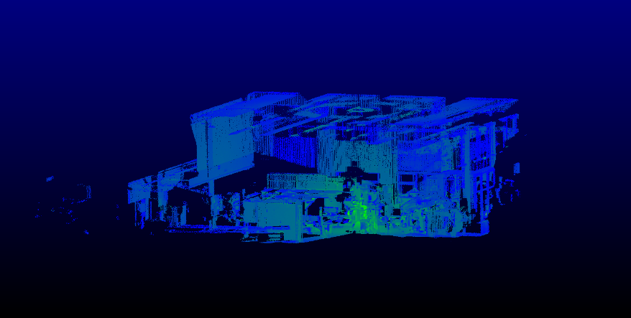
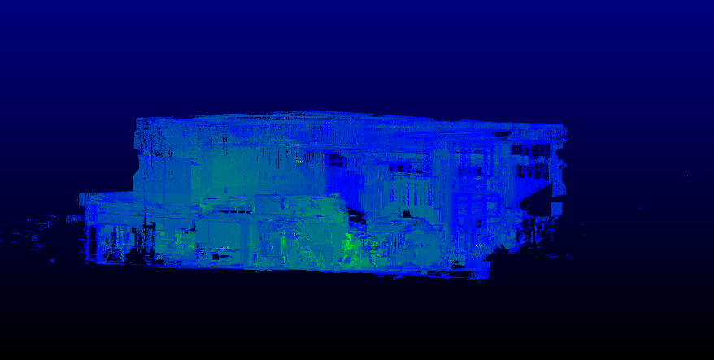
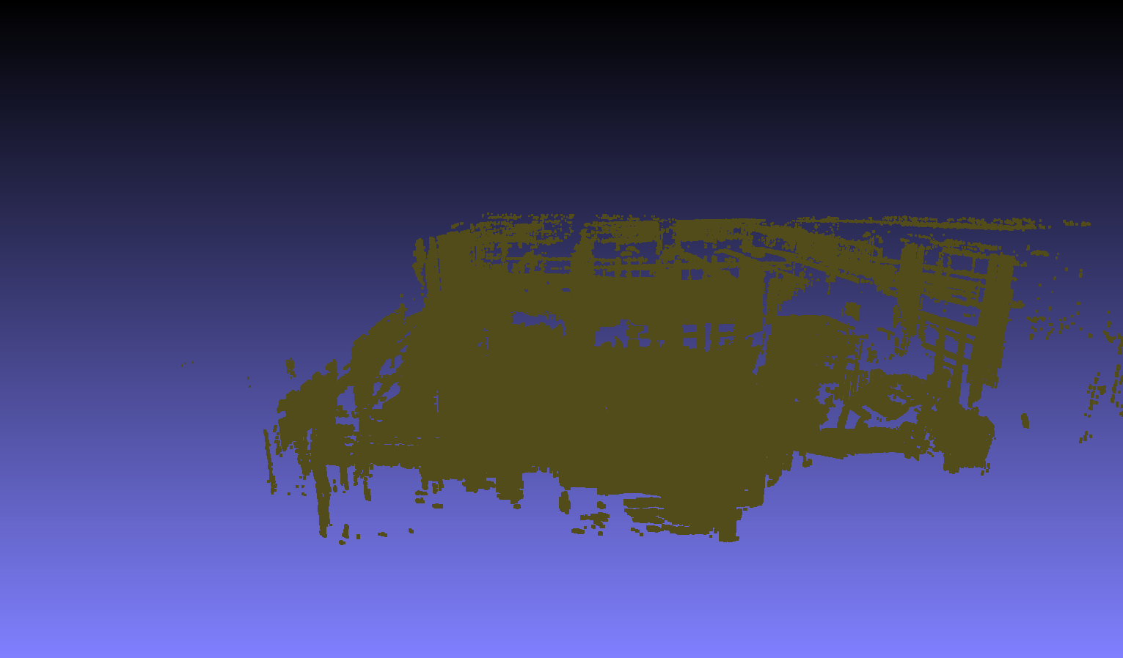
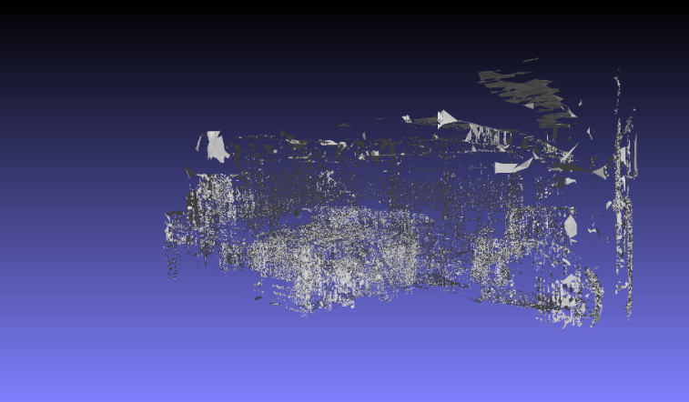
Artifacts generated by the pipeline
Input files (Roughly Aligned Point Clouds)
Output files
Presentation on Research Project
Artifacts generated by the pipeline
-

Slide 23


Performance Evaluation
Reduces Execution time
55% reduction in overall execution time
Appropriate error handling
Parallel processing
Reduction of human interaction
Third Party Software Integration
Easy to use reusable task template
Presentation on Research Project
Performance Evaluation
-

Slide 24
Table of Contents
1. | Introduction and motivation
2. | Core Project Tasks
3. | State of the art
4. | Requirements of the software system
5. | Selection of a workflow Engine
6. | Conceptual 3D Data Processing Pipeline
7. | Evaluation
8. | Conclusion and Outlook
Presentation on Research Project
Table of Contents
-

Slide 25

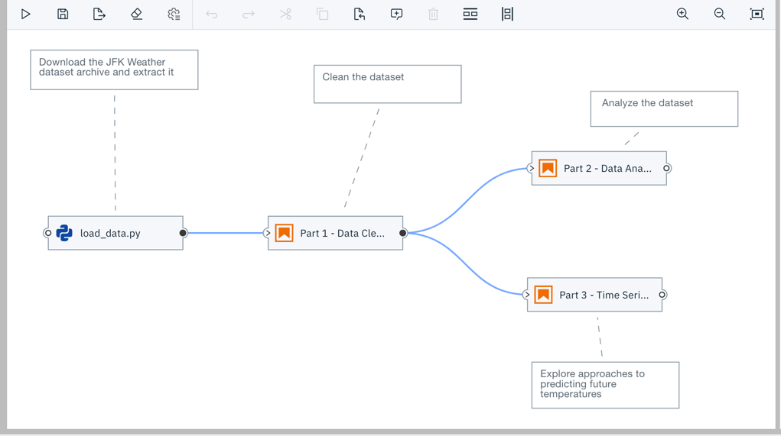


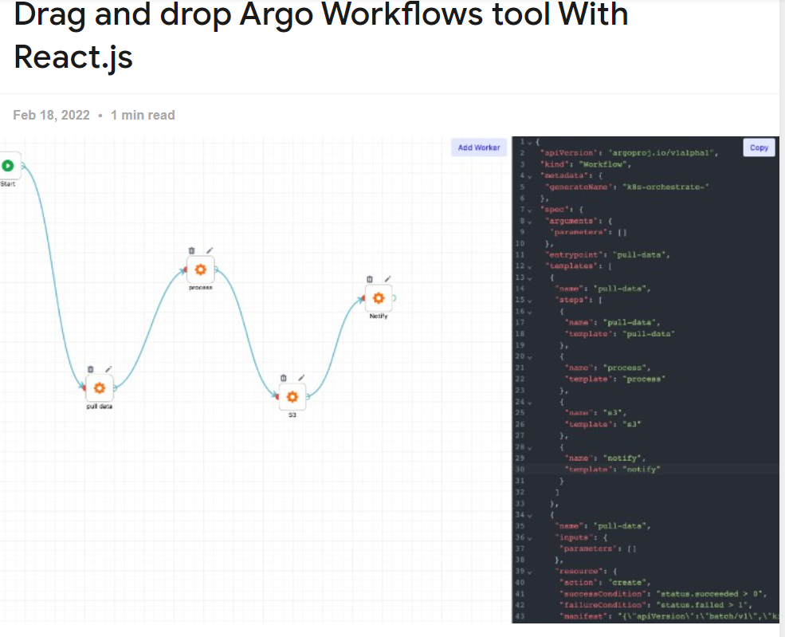



Conclusion and Outlook
Level of Automation
Visual Workflow Editor
[12, 13]
Ease of use
Overall Exe Time
Parallel Processing and Error Handling
More computing power
Presentation on Research Project
Conclusion and Outlook
-

Slide 27
References
[1] |  | Institut für Flugzeug-Produktionstechnik
[2] |  | Hapke, Hannes (2020): Building Machine Learning Pipelines : Automating Model Life Cycles with TensorFlow. Automating model life cycles with TensorFlow. 1st edition. Beijing, Boston, Farnham: O'Reilly Media, Incorporated.
[3] |  | Nick Russell et al. “Workflow Data Patterns: Identification, Representation and Tool Support”. In: Springer, Berlin, Heidelberg, 2005, pp. 353–368. DOI: 10.1007/11568322{\_}23. URL: https://link.springer.com/chapter/10.1007/11568322_23.
[4] |  | Bas Harenslak and Julian de Ruiter. Data pipelines with Apache Airflow. Shelter Island, NY: Manning Publications Co, 2021. ISBN: 9781617296901.
[5] |  | Argo Workflows - The workflow engine for Kubernetes. 5/26/2022. URL: https://argoproj.github.io/argo-workflows/.
[6] |  | Florian Fichtner, Nico Mandery, Maximilian Schwinger, Jonas Eberle, Michael Nolde, Torsten Riedlinger(2021): Scalable Processing Of Copernicus Sentinel satellite Images Using Argo Workflows. In: Proceedings of the 2021 conference on Big Data from Space, 18-20 May 2021, S. 77–80. DOI: 10.2760/125905.
[7] |  | Aurum, Aybüke; Wohlin, Claes (2005): Engineering and managing software requirements. Berlin: Springer.
[8] |  | Kubernetes. Kubernetes Documentation. 5/29/2022. URL: https://kubernetes.io/docs/home/.
[9] |  | Docker Documentation. Docker overview. 5/26/2022. URL: https://docs.docker.com/get-started/overview/.
[10] |  | MinIO, Inc. MinIO | MinIO for Kubernetes. 5/27/2022. URL: https://min.io/product/kubernetes.
[11] |  | Apache Airflow Documentation — Airflow Documentation. 5/25/2022. URL: https://airflow.apache.org/docs/apache-airflow/stable/.
[12] |  | Elyra Documentation — Elyra 3.8.1 documentation. 5/4/2022. URL: https://elyra.readthedocs.io/en/stable/.
[13] |  | React. “Drag and drop Argo Workflows tool With React.js”. In: React.js Examples (2/18/2022). URL: https://reactjsexample.com/drag-and-drop-argo-workflows-tool-with-react-js/.
Presentation on Research Project
References
-

